Slide 1
Templates, Interpolation, and Directives

Slide 2


Slide 3

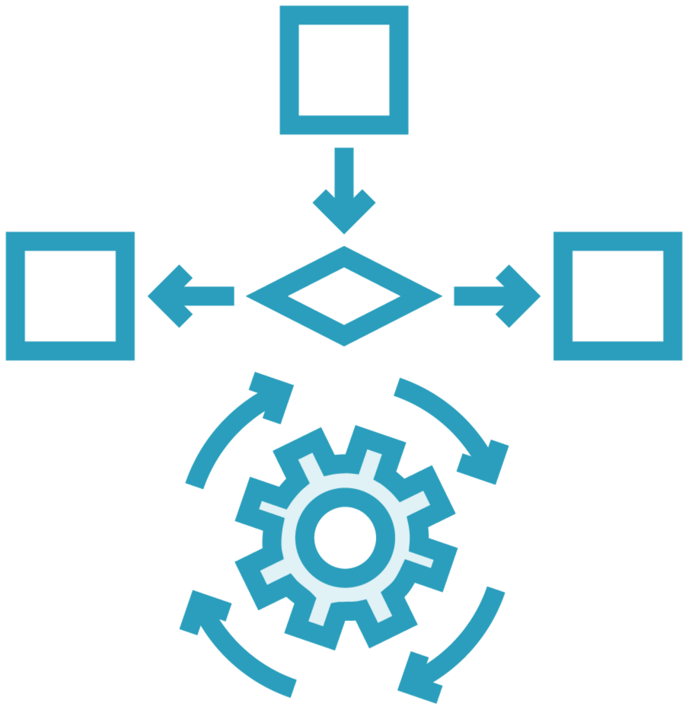

Power up HTML
Data binding
Angular directives
(Custom HTML syntax)
Angular components (Custom Directives)

Slide 4


Component
Class
Component
=
Template
+
Properties
+
Metadata
Methods

Slide 5
Module Overview
Building a template
Using a component as a directive Binding with interpolation Adding logic with directives

Slide 6
Application Architecture
Welcome Component
index.html
App Component
Product List Component
Star Component
Product Detail Component
Product Data Service

Slide 7
Component
app.component.ts
import { Component } from '@angular/core';
@Component({
selector: 'pm-root', template: `
<div><h1>{{pageTitle}}</h1>
<div>My First Component</div>
</div>
`
})
export class AppComponent {
pageTitle: string = 'Acme Product Management';
}

Slide 8
Defining a Template in a Component
Inline Template Inline Template Linked Template
template: `
<div>
<h1>{{pageTitle}}</h1>
<div>
My First Component
</div>
</div>
templateUrl:
'./product-list.component.html'
template: "<h1>{{pageTitle}}</h1>"
`
ES 2015
Back Ticks

Slide 9
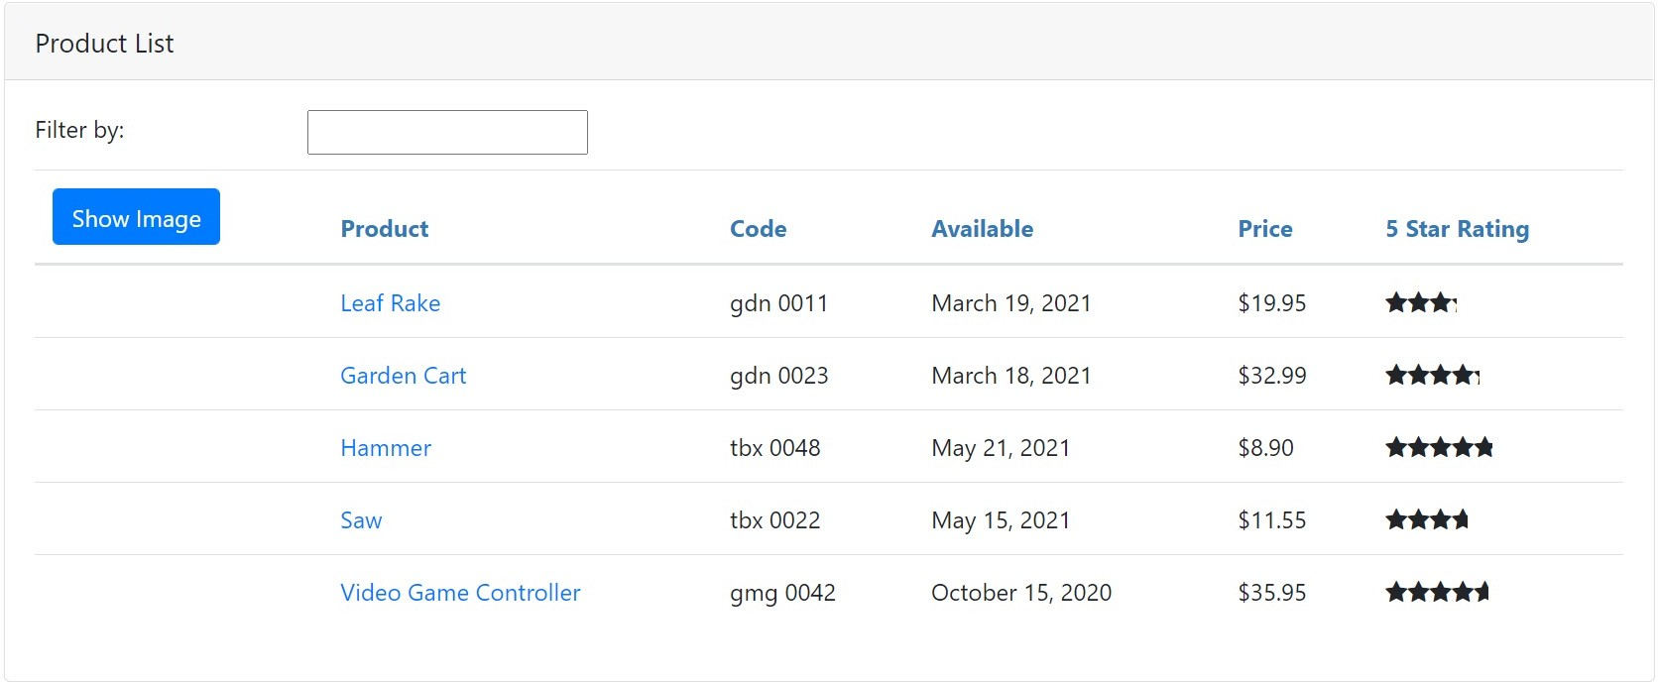
Product List View

Slide 10
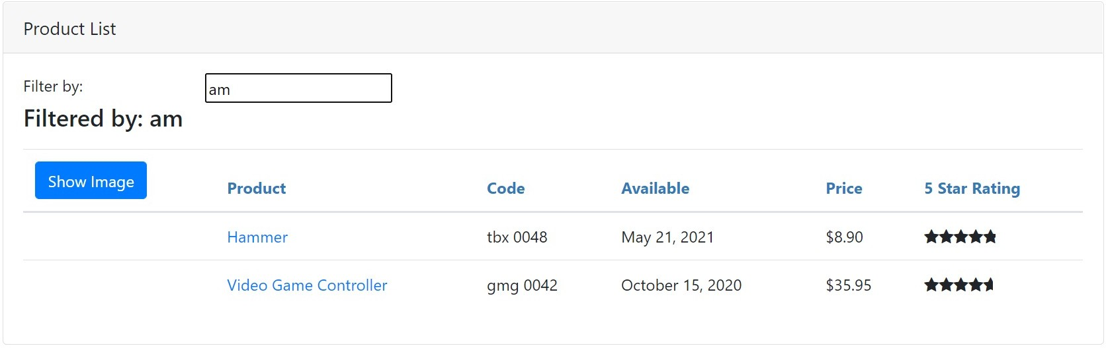
Product List View

Slide 11
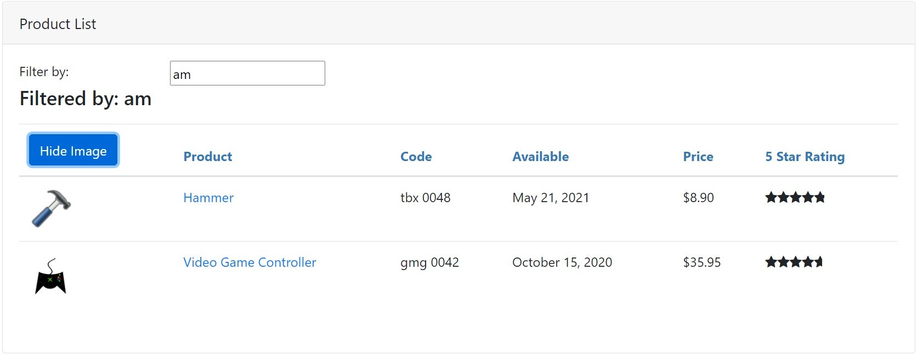
Product List View

Slide 12
Product List View
https://getbootstrap.com/
https://fontawesome.com

Slide 13
Building the Component
product-list.component.ts
import { Component } from '@angular/core';
@Component({
selector: 'pm-products',
templateUrl: './product-list.component.html'
})
export class ProductListComponent { pageTitle: string = 'Product List';
}

Slide 14
Using a Component as a Directive
app.component.ts
product-list.component.ts
@Component({ selector: 'pm-root', template: `
<div><h1>{{pageTitle}}</h1>
<div>My First Component</div>
</div>`
})
export class AppComponent { }
@Component({
selector: 'pm-products', templateURL:
'./product-list.component.html'
})
export class ProductListComponent { }

Slide 15
Using a Component as a Directive
app.component.ts
product-list.component.ts
@Component({ selector: 'pm-root', template: `
<div><h1>{{pageTitle}}</h1>
<pm-products></pm-products>
</div>`
})
export class AppComponent { }
@Component({
selector: 'pm-products', templateURL:
'./product-list.component.html'
})
export class ProductListComponent { }

Slide 16
BrowserModule
AppModule
AppComponent
Imports Exports Declarations Bootstrap

Slide 17
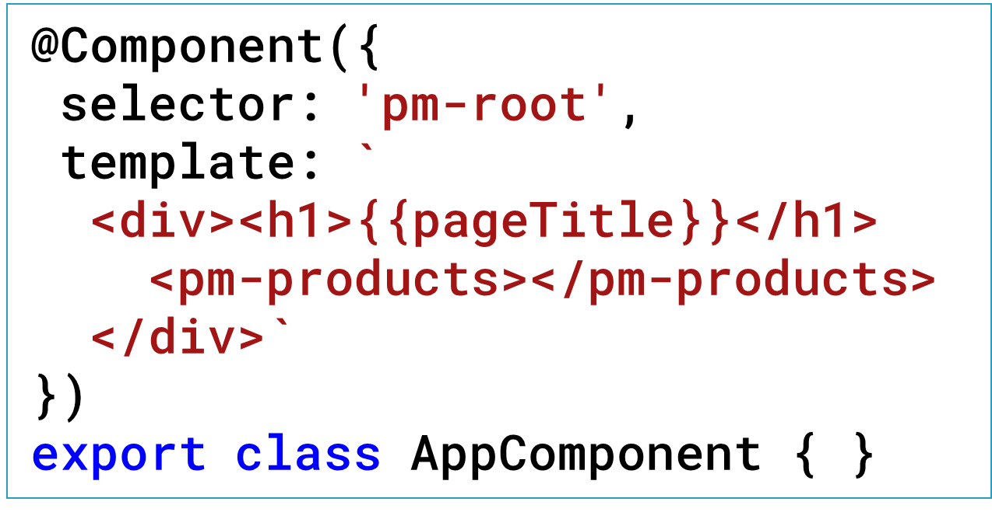
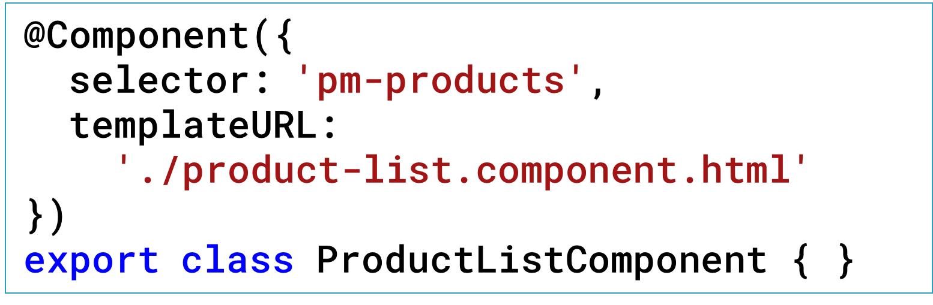
BrowserModule
AppModule
AppComponent
ProductList - Component
Imports Exports Declarations Bootstrap

Slide 18


Binding
Coordinates communication between the component's class and its template and often involves passing data.
Class
Template
Properties
Methods

Slide 19
Interpolation
Template
Class
<h1>{{pageTitle}}</h1>
{{'Title: ' + pageTitle}}
{{2*20+1}}
export class AppComponent { pageTitle: string =
'Acme Product Management';
}
<h1 innerText={{pageTitle}}></h1>

Slide 20
Directive
Custom HTML element or attribute used to power up and extend our HTML.
Custom
Built-In

Slide 21
Custom Directives
app.component.ts
product-list.component.ts
@Component({
selector: 'pm-root', template: `
<div><h1>{{pageTitle}}</h1>
<pm-products></pm-products>
</div>
`
})
export class AppComponent { }
@Component({
selector: 'pm-products', templateURL:
'./product-list.component.html'
})
export class ProductListComponent { }

Slide 22
Angular Built-in Directives
*ngIf: If logic
*ngFor: For loops
Structural Directives

Slide 23
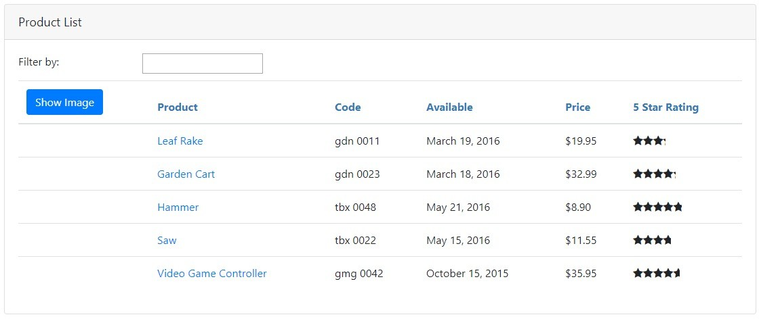
*ngIf Built-In Directive
<div class='table-responsive'>
<table class='table' *ngIf='products.length'>
<thead> ...
</thead>
<tbody> ...
</tbody>
</table>
</div>

Slide 24
BrowserModule
AppModule
AppComponent
ProductList - Component
Imports Exports Declarations Bootstrap

Slide 25
*ngFor Built-In Directive
<tr *ngFor='let product of products'>
<td></td>
<td>{{ product.productName }}</td>
<td>{{ product.productCode }}</td>
<td>{{ product.releaseDate }}</td>
<td>{{ product.price }}</td>
<td>{{ product.starRating }}</td>
</tr>

Slide 26
for…of vs for…in
for…of
Iterates over iterable objects, such as an array.
Result: di, boo, punkeye
let nicknames= ['di', 'boo', 'punkeye'];
for (let nickname of nicknames) { console.log(nickname);
}
for…in
Iterates over the properties of an object.
Result: 0, 1, 2
let nicknames= ['di', 'boo', 'punkeye'];
for (let nickname in nicknames) { console.log(nickname);
}

Slide 27
*ngFor Built-In Directive
<tr *ngFor='let product of products'>
<td></td>
<td>{{ product.productName }}</td>
<td>{{ product.productCode }}</td>
<td>{{ product.releaseDate }}</td>
<td>{{ product.price }}</td>
<td>{{ product.starRating }}</td>
</tr>

Slide 28
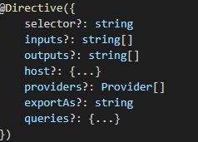
@Directive decorator
Directive decorator and metadata Properties -

Slide 29
Selector

Slide 30
Inputs

Slide 31

Host

Slide 32
Demo
How to Create Custom Directives?

Slide 33

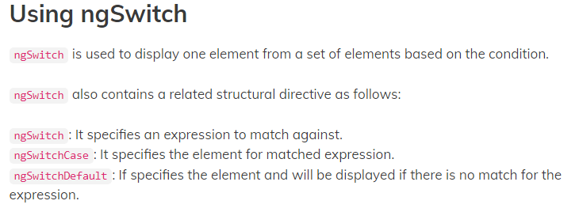
ngSwitch Directive

Slide 35

Template Checklist: Inline
Template
For short templates
Specify the template property
Use the ES 2015 back ticks for multiple lines Watch syntax
template: `
<div><h1>{{pageTitle}}</h1>
<div>My First Component</div>
</div>`

Slide 36
Template Checklist: Linked
Template
For longer templates
Specify the templateUrl property Define the path to the HTML file
templateURL: './product-list.component.html'

Slide 37
Checklist: Component as a Directive
product-list.component.ts
@Component({
selector: 'pm-products', templateURL:
'./product-list.component.html'
})
export class ProductListComponent { }
app.component.ts
app.module.ts
@Component({ selector: 'pm-root', template: `
<div><h1>{{pageTitle}}</h1>
<pm-products></pm-products>
</div>`
})
export class AppComponent { }
@NgModule({
imports: [ BrowserModule ], declarations: [
AppComponent, ProductListComponent ],
bootstrap: [ AppComponent ]
})
export class AppModule { }

Slide 38
Template Checklist: Interpolation
One way binding
From component class property to an element property
Defined with double curly braces
Contains a template expression
No quote needed
<td>{{ product.productName }}</td>

Slide 39
Template Checklist: Structural Directives
*ngIf and *ngFor
Prefix with an asterisk
Assign to a quoted string expression

Slide 40
Template Checklist:
*ngIf
Add or remove an element and its children from the DOM
Expression is evaluated:
true: elements added to the DOM
false: elements removed from the DOM
<table *ngIf='products'>

Slide 41
Template Checklist:
*ngFor
Repeat an element and its children in the DOM
- For each object in an iterable list
Define the local variable with let
Specify 'of'
<tr *ngFor='let product of products’>
...
</tr>

Slide 42
Application Architecture
Welcome Component
index.html
App Component
Product List Component
Star Component
Product Detail Component
Product Data Service

Slide 43
Application Architecture
Welcome Component
index.html
App Component
Product List Component
Star Component
Product Detail Component
Product Data Service

Slide 44

Coming up next …
Data Binding & Pipes

